Slide 1


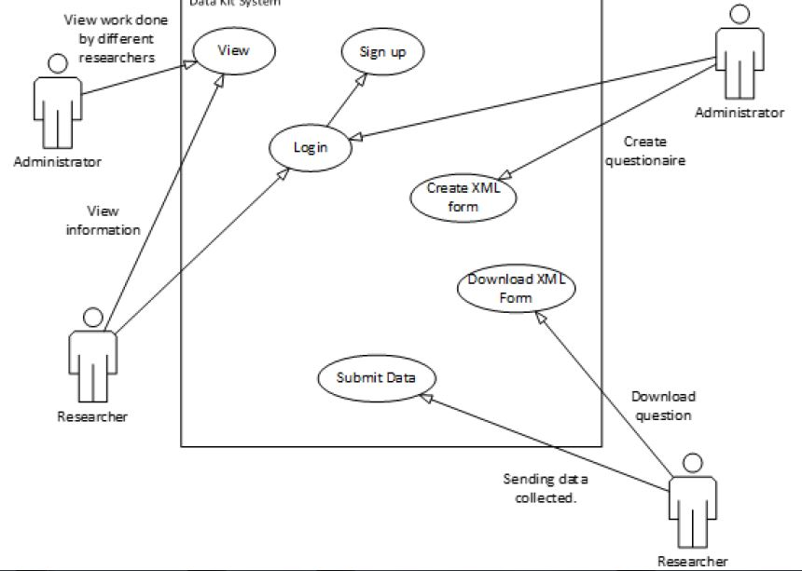
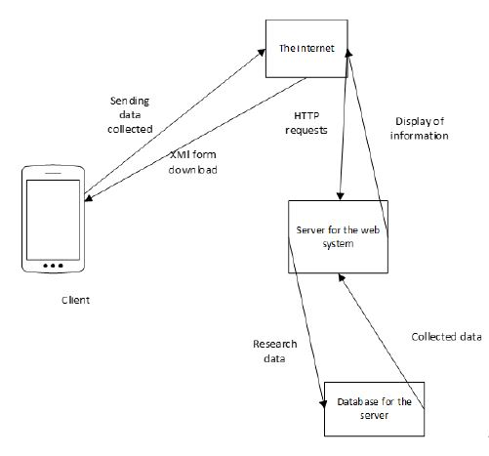
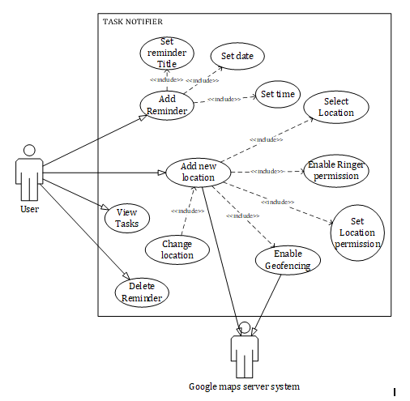
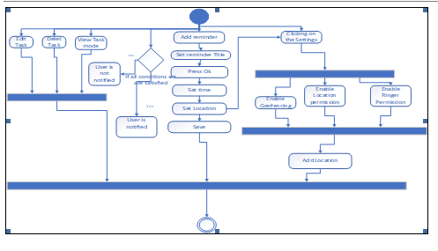
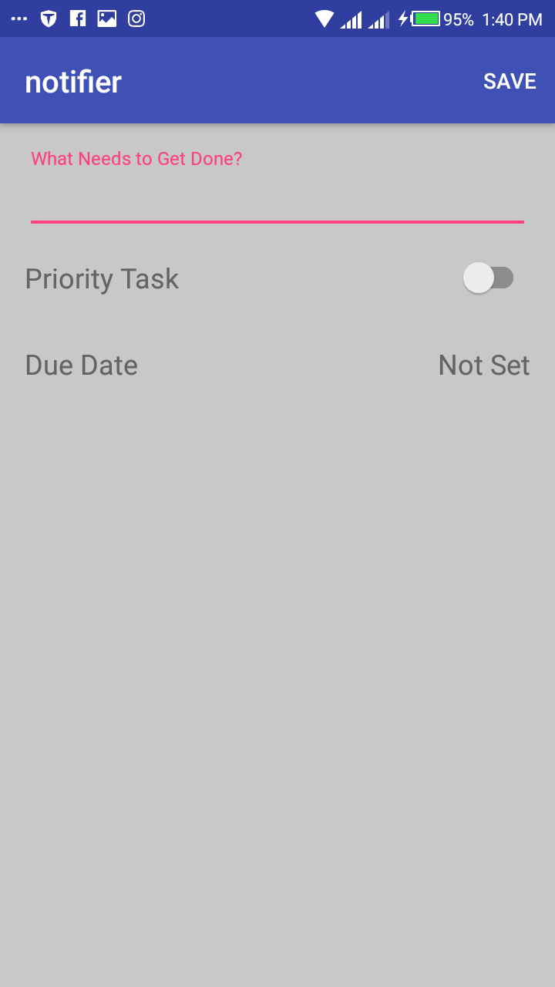
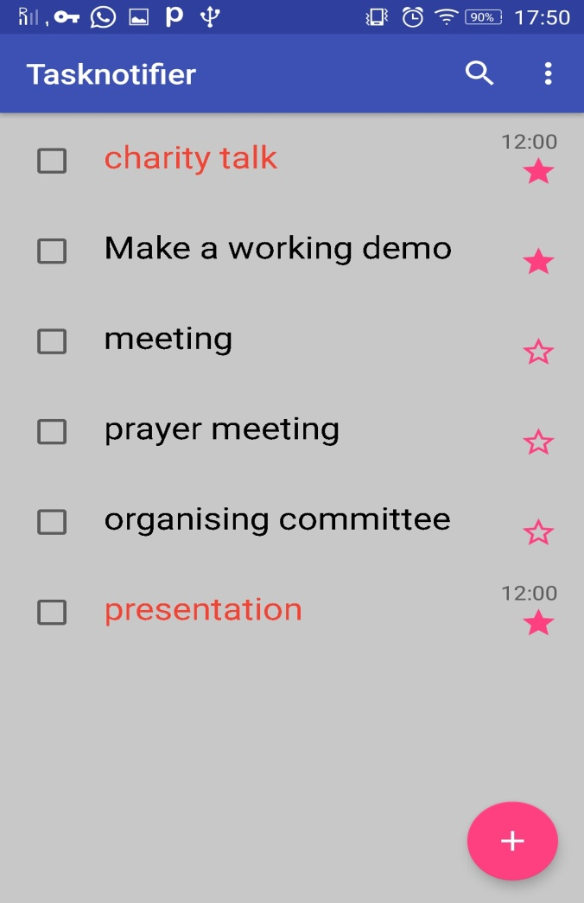
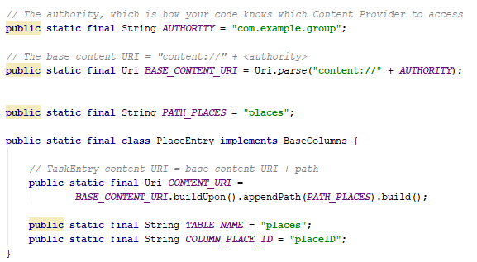
TASK NOTIFIER APP
Enable the application to make multiple geofences.
Upload on google play store.
Enable the application to make multiple geofences.
Upload on google play store.
COLLECT YOUR DATA WITH DATA KIT APP
GROUP: CSC 19-9
Prepared By;
Abilla Rapheal ,Mwaita Joshua ,Ojiambo Abel, Nakafeero Peninah
Supervisor: Madam Babara Nansamba
Problem
Use Case
System architecture
At times people tend to forget to do certain activities when they reach certain locations. This may occur because such activities are not regularly done. For example, students some times forget to download notes when they reach their respective colleges.
.
MAIN OBJECTIVE
To develop an automated online research tool system that will increase the efficiency in the process of collection and analysis of data by micro-finance institutions and to recommend on the areas in which more research is required.
Over the course of the project , our team developed strong communication skills , a variety of planning and development skills, and experience working together as a group .
Some real-life applicable knowledge that our group gleaned includes the use of a calendar to setup the date when the notification is to be received.
Designs/Results
implementation
SPECIFIC OBJECTIVES
Enable Geofences
Capturing location
Select location
Add location
To establish requirements to the real time research tool system.
To design the android and web application sections for the Data kit system.
To implement the designed android and web application section for the data kit system.
To test and validate the Data kit system.
scope
Functional Requirements
The study is focused on producing a real time research tool to help micro-finance institutions in gathering and analyzing information about the financial status of peasant farmers in Uganda so as to offer them loans to improve on their agricultural practices thus boosting the Agricultural sector financially.
An internet connection to download the application
Enable Geofences
Configure location permissions.
Add New Location.
Schedule Task
View the calendar to set the date
Set a priority task
Save , delete and update a task
SAMPLE CODE SNIPPET
References
kothani, C. (2004). Research methodology methods and technology. New age International Publishers.
Wilbrod Ntawiha, B. A. (2016). Ugandas data ecosystem. A quantitative review of data production in Uganda.
System requirements
Android operating system
Screen resolution 480 x 800 or larger
Display 5 inches or bigger
API 28 or lower
Enable the application to make multiple geof
Notes:
To change this poster, replace our sample content with your own. Or, if you'd rather start from a clean slate, press the New Slide button on the Home tab to insert a new page. Now enter your text and pictures in the empty placeholders. If you need more placeholders for titles, subtitles or body text, copy any of the existing placeholders, then drag the new one into place.

